Slide 1
Unit Testing with JUnit
Prof. Dr. Dirk Riehle
Friedrich-Alexander University Erlangen-Nürnberg
ADAP B02
Licensed under CC BY 4.0 International
Notes:
It is Friedrich-Alexander University Erlangen-Nürnberg – FAU, in short.
Corporate identity wants us to say “Friedrich-Alexander University”.

Slide 2
Simple Development Cycle
edit
Edit = developer implements new feature
  Iterates over the code until it looks right
Compile = developer compiles the code
  Iterates over the code until it compiles (no syntax error)
Build = developer puts classes, build path together
  Packages jar, if any, by hand
Test = developer tests the program, typically by-hand
  Keeps going until “behavior looks right” i.e. no bugs
Commit = developer commits to code repository
  If a student, submits homework
compile
build
test
commit

Slide 3
What’s Wrong with “Test-by-hand”?
Manual testing
  takes time that can be saved by automation
  is not as reliable as programmed tests
  tends to be selective, not comprehensive
But: Human intuition can see problems that computers cannot

Slide 4
Tests and Testing
Testing is a process
  that tests some concern (the concern “under test”)
  for correct and expected operation
  according to a specification
  usually as part of quality assurance
Tests can be manual or automated
Tests verify against a given specification
Tests increase confidence in correct functioning
However, tests can never proof a program correct

Slide 5
Types of Tests [1]
Components tests (a.k.a. unit tests)
  Focus on testing one component out of context
Acceptance tests (a.k.a. functional tests)
  Focus on testing one cross-cutting functionality
Integration tests (a.k.a. system tests)
  Focus on testing end-to-end system integrity
[1] This is a simplification for the purposes of this course.

Slide 6
Test Types by other Dimensions
Inner vs. outer perspective
  Black-box tests
    Tests are written to test outside observable behavior
  White-box tests
    Tests are written to test the innards of a component
Static vs. dynamic perspective
  Static-analysis based
    Tests are written based on static code analysis
  Run-time analysis based
    Tests are written based on simulated behavior
Other dimensions (see dedicated courses)

Slide 7
Tests and Testing Terminology
Test (Case)
  A single test for some particular aspect of the software, succeeds or fails
Test Suite
  A set of related tests that cover a particular domain of the software
Test Set-up
  The data and preparation necessary to run a test as intended
Test Result
  The result of running a test, typically succeeds/fails or error
Test Harness
  A software, like JUnit, that is used to run test suites

Slide 8
Example of Test Harness
JUnit (Java Unit Testing Framework)
  A test harness implemented as an object-oriented testing framework
  Supports tests and test suites, set-ups, tear-downs, etc.
  Small and simple, easy to learn
  Well-supported by tools / integrated into IDEs like Eclipse
JUnit popularized unit testing: “Never in the field of software development have so many owed so much to so few lines of code.” [M07]

Slide 9
JUnit Information
Available from http://junit.org
  Comes as pre-installed plug-in with Eclipse and most other IDEs
  See course literature for an introduction to JUnit
Version history of JUnit
  Prior to JUnit 4.0 conventions rather than annotations
  Wahlzeit by now should have switched to 4.0 (used to be 3.8)

Slide 10
Example for Unit Testing
JValue Value Objects
  A framework for value objects in Java (more on value objects later)
    Examples are names, currencies, SI units, etc.
  Is a small self-contained library → good for unit testing
  Available at https://github.com/jvalue/value-objects

Slide 11
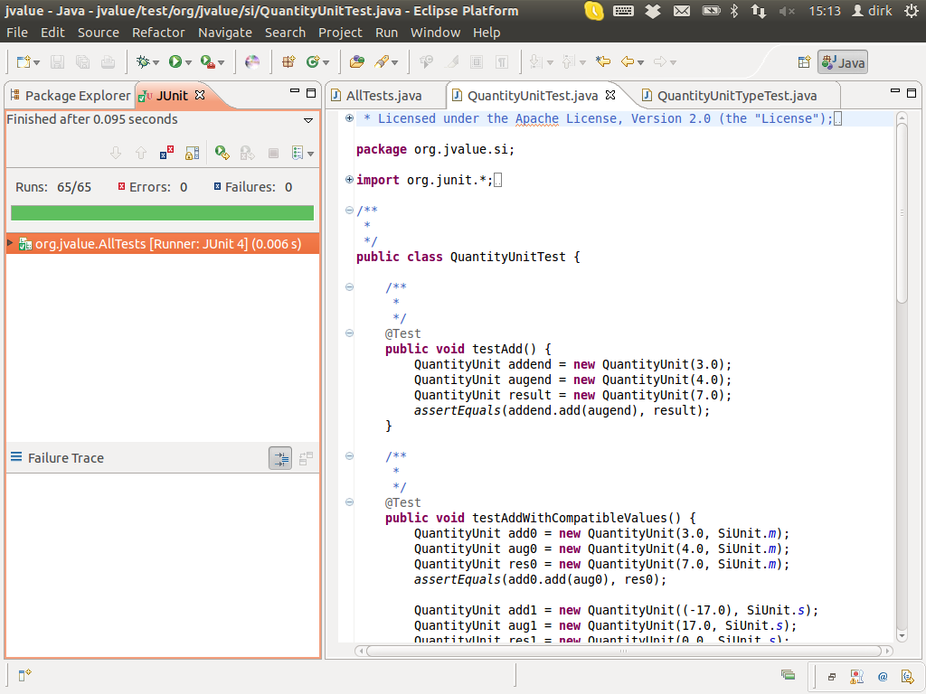
JUnit for JValue using Eclipse Plug-In

Slide 12
Test Cases in JUnit
Tests are implemented in test classes
  JUnit v4.0 or later
    Annotate test method with @Test
    End class name with Test (optional)
  JUnit v3.8 or before
    Start test method name with “test”
    End test class name with “Test”

Slide 13
Two Example Test Cases
@Test
public void testEquality1() {
String[] helloWorld = { "hello", "world", "!" };
Name defaultName = new DefaultName(helloWorld);
Name compactName = new CompactName(helloWorld);
Assert.assertEquals(defaultName, compactName);
}
@Test
public void testEquality2() {
String[] charMalaise = { "\\###\\", "#", "\\", "\\\\\\\\#", "#" };
Name defaultName = new DefaultName(charMalaise);
Name compactName = new CompactName(charMalaise);
Assert.assertEquals(defaultName, compactName);
}

Slide 14
How to Write a Test (3A Pattern)
Arrange
Act (execute)
Assert (check)

Slide 15
Example of 3A
import org.junit.*;
import static org.junit.Assert.*;
public class QuantityUnitTest {
@Test
public void testAdd() {
QuantityUnit addend = new QuantityUnit(3.0, SIUnit.s);
QuantityUnit augend = new QuantityUnit(4.0, SIUnit.s);
QuantityUnit result = new QuantityUnit(7.0, SIUnit.s);
assertEquals(addend.add(augend), result);
}
...
1. Arrange
3. Assert
2. Act

Slide 16
By-Test-Case Test Set-ups in JUnit
Annotation @before implements set-up method
  Is executed before each test case (method) in a given class
  Used to be (naming convention) setUp
Annotation @after implements tear-down method
  Is executed after each test case (method) in a given class
  Used to be (naming convention) tearDown

Slide 17
Example of a Test Set-up
protected Name ne; // empty name
protected Name n0; // ("")
protected Name n1; // ("org", '.')
protected Name n2; // ("jvalue.org", '.')
@Before
public void setUp() {
ne = Name.EMPTY_NAME;
n0 = getName("");
n1 = getName("org", '.');
n2 = getName("jvalue.org", '.');
}
@Test
public void testEquals() {
assertEquals(n0, getName(""));
assertEquals(n1, getName("org"));
assertEquals(n2, getName("jvalue#org"));
}
...
1. Arrange
2. Act
3. Assert

Slide 18
Test Results
Pass / fail
Test execution error

Slide 19
Checking for Pass / Fail
Explicit assertions / failures in code
  assert(...)
  fail(...)
Annotations with expected results
  @Test(expected = SomeException.class)
  @Test(timeout = 500)

Slide 20
Another Example of 3A
public class FlagReasonTest {
private Map<FlagReason, TestEntry> entries;
@Before
public void setUp() {
entries = new HashMap<FlagReason, TestEntry>();
addEntry(FlagReason.MISMATCH, "mismatch", 0);
addEntry(FlagReason.OFFENSIVE, "offensive", 1);
...
}
protected void addEntry(FlagReason reason, String str, int i) {
entries.put(reason, new TestEntry(str, i));
}
@Test(expected = IllegalArgumentException.class)
public void tooBigIndexShouldCauseException() {
FlagReason.getFromInt(FlagReason.MAX_VALUE + 1);
}
...
1. Arrange
2. Act
3. Assert

Slide 21
Test Suite
A test suite groups related tests into one group (object)
This allows the group to share the same set-up, if desired
Test suites are applied recursively to build full test hierarchy
Tests can be run starting with any test suite in the hierarchy
The test suites typically mirror the Java package structure
:TS
...
...
:TS
:TS
:TS
:TS
...
...
:TC
:TC
...
:TC
:TC
...
:TC

Slide 22
Test Suites in JUnit
JUnit realization of Test Suites
  JUnit 4.0 or later
    Have become mostly invisible
    Can still be used to collect test cases across classes
  JUnit 3.8 or before
    Create new TestSuite instance using “new TestSuite()”
    Collect test suites using “addTestSuite(Test.class)”

Slide 23
Example of (By-Hand) Test Suite
import org.junit.*;
import static org.junit.Assert.*;
public class QuantityUnitTest {
@Test
public void testAddWithCompatibleValues() {...}
@Test(expected = IllegalArgumentException.class)
public void testAddWithIncompatibleValues() {...}
...
}
import org.junit.runner.*;
import org.junit.runners.*;
@RunWith(Suite.class)
@Suite.SuiteClasses({
org.jvalue.si.QuantityUnitTest.class,
org.jvalue.si.QuantityUnitTypeTest.class,
...
})
public class AllTests { /** do nothing **/ }

Slide 24
Static By-Test-Suite Test Set-ups
Annotation @BeforeClass implements (static) set-up method
  Is executed once before any test case in the class is run
  Used to be TestSetup subclass (decorator)
Annotation @AfterClass implements (static) tear-down method
  Is executed once after all the test cases in the class have run
  Used to be TestSetup subclass (decorator)
Applies to (heavy-weight) required resources

Slide 25
Dynamic By-Test-Suite Test Set-ups
TestRule supports dynamic set-up and tear-down
  Test rules are attached to test suites in the test hierarchy
Rule chain supports composition of test rules
  Rule chain lines up test rules in sequence
  Fluid programming style chains methods
Supports method and class-level execution
  Use @Rule and @ClassRule analogous to @Before and @BeforeClass

Slide 26
Rule-based Test Set-ups
client
:TS
:TR
...
:TR
:TR
:TS
:TS
:TS
...
...
:TC
:TC
...
:TC
:TR
:TS
:TC
...
:TC

Slide 27
Wahlzeit on GAE RuleChain for JUnit
@ClassRule
public static RuleChain ruleChain = RuleChain.
outerRule(new LocalDatastoreServiceTestConfigProvider()).
around(new RegisteredOfyEnvironmentProvider()).
around(new SysConfigProvider()).
around(new UserServiceProvider()).
around(new UserSessionProvider());
This RuleChain instance initializes most of what you’ll need
It may be an overkill for most situations but gets you going
Example to be found in org.wahlzeit.services.LogBuilderTest

Slide 28
System-Specific Set-up and Tear-down
More complex set-ups to be run once or only a few times
Should be implemented in their own class, to be reused
Applies, for example, to heavyweight database set-up
In JUnit 4.0+ to be implemented as ExternalResource

Slide 29
Location and Scope of Test Set-ups
Test case
  With test method (directly by calling set-up method)
  Within test class, using @Before annotation
Test suite
  Within test class, using @BeforeClass annotation
  With rules and rule chain, using separate classes
System
  As external resources called from outer test suite

Slide 30
Test Source Code Organization
Three scopes of organizing tests
  Within the same class
  Within the same package
  Within the same package hierarchy
File locations depend on build tool
  In Gradle, test directory captures all tests, branches of src
    $project/src/main/java
    $project/src/test/java
Test package hierarchy should mirror the main hierarchy

Slide 31
Quiz: Simple Test Set-up
Your tests for the Money class all need a few example values to work with. Where should you create them?
  In each test case method
  In the test class' setup method
  In a separate test setup class
You are programming tests for a Money.divideBy() method. Should you also test for any possible ArithmethicException?
  Never
  Always
  Depends

Slide 32
Advanced Testing Concepts
Handling complex system set-ups
  Mocking, stubbing, nulling
  Dependency injection
Testing specific system aspects
  Concurrency
  Legacy code
Test structure and practicality
  Extent of tests run, run-time

Slide 33
Review / Summary of Session
General testing
  What are tests? What is testing?
  What types of tests are there?
Testing and JUnit
  What is JUnit and how can it help you write tests?
  What are the most basic annotations you’ll need?
Pragmatics of testing with JUnit
  How are they aggregated into test suites?
  How do you create test set-ups?

Slide 34
Thanks! Questions?
dirk.riehle@fau.de – http://osr.cs.fau.de
dirk@riehle.org – http://dirkriehle.com – @dirkriehle
DR

Slide 35
Credits and License
Original version
  © 2012-2018 Dirk Riehle, some rights reserved
  Licensed under a Creative Commons Attribution 4.0 International License
Contributions
  ...

